Slide 1
Chapter 8
Ashland MultiComm Services
Case Study - Group 3

Slide 2
Overview
AMS wants to increase their subscribers for their 3-For-All cable TV & Internet and smartphone service
AMS conducted a survey to determine the characteristics of the households who would subscribe to their service
Out of the 500 households they selected to survey, 82 did not respond, leaving a 418 as the applicable sample
We want to discuss the marketing implications and statistical results of the survey

Slide 3
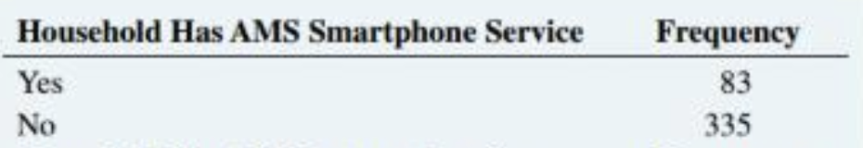
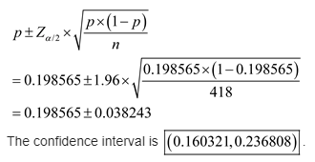
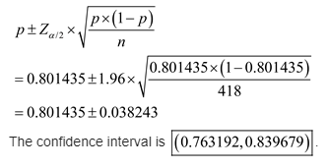
Survey Question #1
Does your household subscribe to smartphone service from Ashland
The confidence intervals show that the maximum number of households they survey were not subscribed to Ashland - so they were able to gather that people do not prefer to subscribe to their telephone services
83 / (335 + 83)
83 / 418
= 0.198565
335 / (335 + 83)
335 / 418
= 0.801435
FOR YES
FOR NO
P for YES
P for NO
16% - 24%
76% - 84%
Notes:
The confidence intervals show that the maximum number of households they survey were not subscribed from Ashland - so they were able to gather that people do not prefer to subscribe to their telephone services

Slide 4
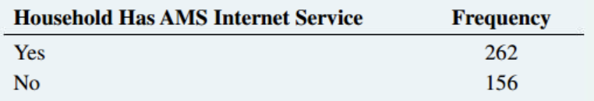
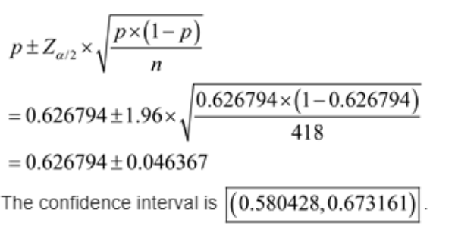
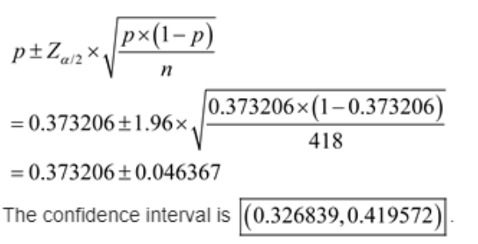
Survey Question #2
Does your household subscribe to Internet service from Ashland
The confidence intervals here show that maximum people prefer internet services from Ashland
The confidence interval of “yes” in telephone services is much less than the confidence interval of “yes” of internet services
262 / (156 + 262)
262 / 418
= 0.626794
156 / (156 + 262)
156 / 418
= 0.373206
FOR YES
FOR NO
P for YES
P for NO
58% - 67%
33% - 41%

Slide 5
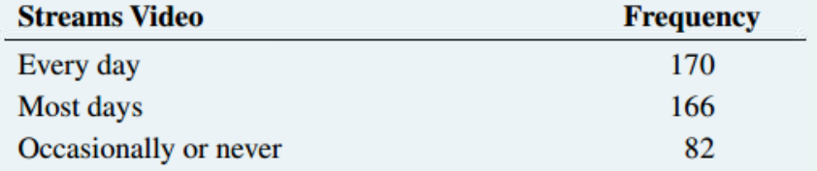
Survey Question #3
How often do you watch streaming video on any device?
Every day Most Days Occasionally
= 170 / 418 = 166 / 418 = 82 / 418
= 0.406699 = 0.397129 = 0.196172
The data shows that many of the AMS surveyees stream video everyday, or most days
This helps AMS see how many of their current customers are using TV and internet services, and that streaming services are a reliable source of revenue for the company

Slide 6
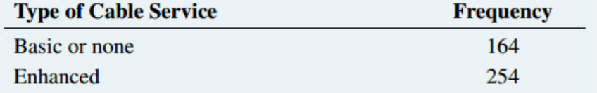
Survey Question #4
What type of cable television service do you have?
We would have a better idea if the frequency of basic and none were separate
If we had this information we would have a better relationship between customers in streams and enrolling in our cable services
Basic / None: 164 / 418 = 0.392344
Enhanced: 254 / 418 = 0.607655

Slide 7
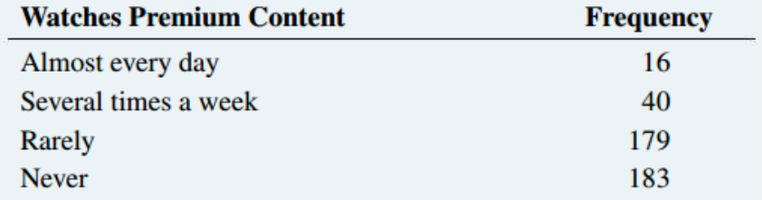
Survey Question #5
How often do you watch premium content that requires an extra fee?
P(Almost every day)= 0.0383
P(Several times a week)= 0.0957
P(Rarely)= 0.4282
P(Never)= 0.1962
The data shows that many of the AMS surveyees would NOT or rarely watch premium content if that content requires a fee
This information can be used advantageously to AMS business model, whether to either reduce their fees, or get rid of them altogether

Slide 8
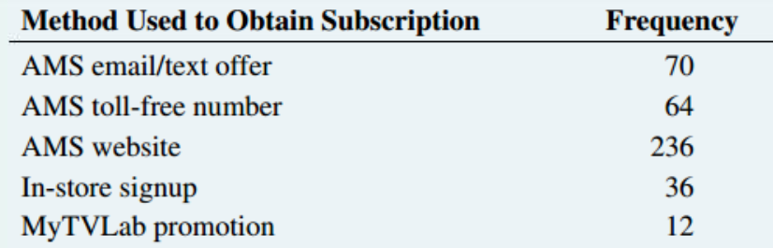
Survey Question #6
What method did you use to obtain your current AMS subscription?
P(email/text offer)= 0.1675
P(toll-free number)= 0.1531
P(AMS Website)= 0.5646
P(In-store)= 0.0861
P(TV Lab promo)= 0.0287
Most frequent method of enrollment was AMS Website
Customers felt most comfortable enrolling via the website
AMS website should be target channel for promoting the 3-For-All

Slide 9
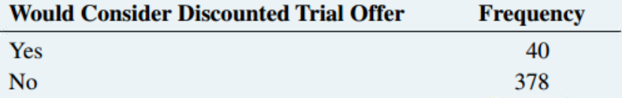
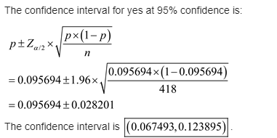
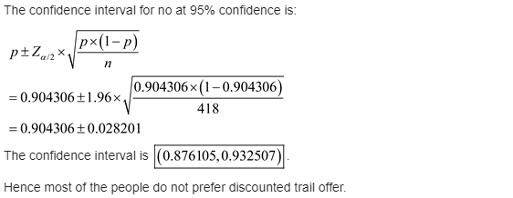
Survey Question #7
Would you consider subscribing to the 3-For-All service for a trial period if a discount were offered?
p(Yes) = 0.095694
p(No) = 0.904306
Most people will not consider joining the 3-for-all even at a discounted price because if they dont use one of the three services then there is no point in getting it at all.

Slide 10
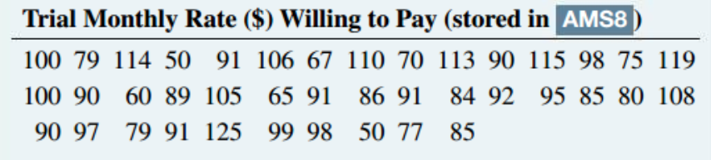
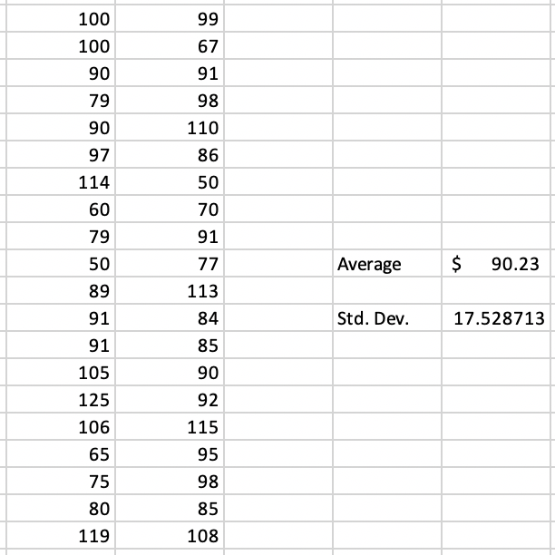
Survey Question #8
The data shows that many of the AMS surveyees would pay an average of $90.23 for the 3-for-1 service, with a standard deviation of 17.528713

Slide 11
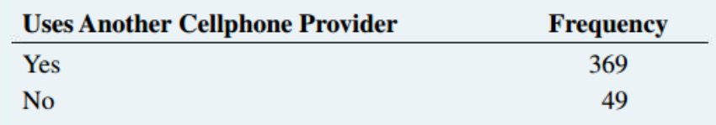
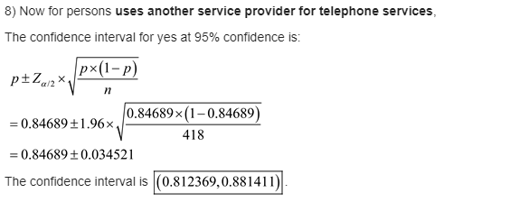
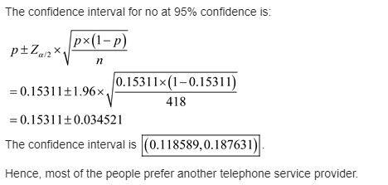
Survey Question #9
P(Uses Another Provider)= 0.8828
P(Does Not Use Another Provider)=0.1172
P(Subscribes to AMS Cell Service)= 0.1986
P(Does Not Subscribe to AMS Cell Service)= 0.8014
Many of the surveyees use other cell phone providers, which decreases their success in obtaining customers for their 3-for-1 deal

Slide 12
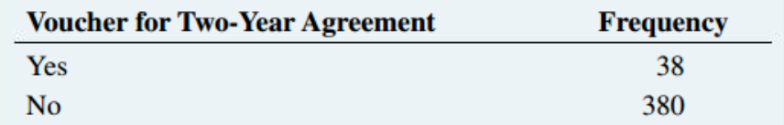
Survey Question #10
AMS may distribute vouchers for one free smartphone for subscribers who agree to a two year subscription contract to the 3-for-all service. Would being eligible to receive a voucher cause you to agree to a two year term?
Even though AMS is offering a free smartphone it will not encourage people to get a two year subscription because if they only use one or two of their services it does not make much sense to get a subscription that gets you all three services. This is similar to question 7 where it asks the same thing but instead of the free smartphone it is a discounted price. People don't seem to care too much about the offers if they only use one or two of AMS services
Notes:
Pat

Slide 13
Thank you | Questions?

